Slide 1
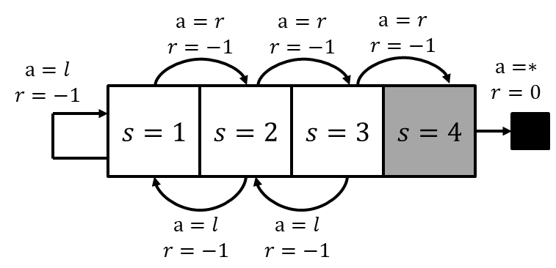
L7.2.X Linear Chain Example
Zonghua Gu 2021
Acknowledgement: slides based on https://www.coursera.org/specializations/reinforcement-learning
And textbook by Sutton and Barto http://incompleteideas.net/book/the-book-2nd.html
Notes:
https://blog.floydhub.com/an-introduction-to-q-learning-reinforcement-learning/

Slide 2
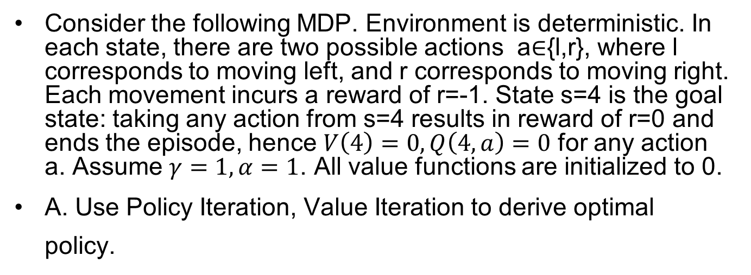
Linear Chain Example
Consider the following MDP. Environment is deterministic. In each state, there are two possible actions a∈{l,r}, where l corresponds to moving left, and r corresponds to moving right. Each movement incurs a reward of r=-1. State s=4 is the goal state: taking any action from s=4 results in reward of r=0 and ends the episode, hence $V\left(4\right)=0,Q\left(4,a\right)=0$ for any action a. Assume $γ=1, α=1$. All value functions are initialized to 0.
A. Use Policy Iteration, Value Iteration to derive optimal policy.

Slide 3
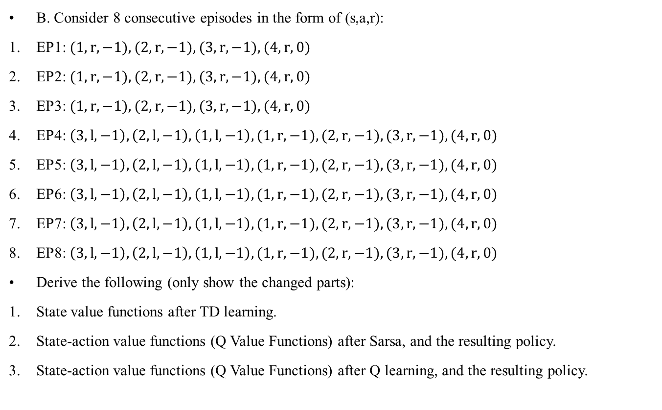
TD, Sarsa, QL
B. Consider 8 consecutive episodes in the form of (s,a,r):
EP1: $(1, r, −1),(2, r, −1),(3, r, −1),(4, r, 0)$
EP2: $(1, r, −1),(2, r, −1),(3, r, −1),(4, r, 0)$
EP3: $(1, r, −1),(2, r, −1),(3, r, −1),(4, r, 0)$
EP4: $\left(3, l, −1\right),\left(2, l, −1\right),\left(1,l, −1\right),(1, r, −1),(2, r, −1),(3, r, −1),(4, r, 0)$
EP5: $\left(3, l, −1\right),\left(2, l, −1\right),\left(1,l, −1\right),(1, r, −1),(2, r, −1),(3, r, −1),(4, r, 0)$
EP6: $\left(3, l, −1\right),\left(2, l, −1\right),\left(1,l, −1\right),(1, r, −1),(2, r, −1),(3, r, −1),(4, r, 0)$
EP7: $\left(3, l, −1\right),\left(2, l, −1\right),\left(1,l, −1\right),(1, r, −1),(2, r, −1),(3, r, −1),(4, r, 0)$
EP8: $\left(3, l, −1\right),\left(2, l, −1\right),\left(1,l, −1\right),(1, r, −1),(2, r, −1),(3, r, −1),(4, r, 0)$
Derive the following (only show the changed parts):
State value functions after TD learning.
State-action value functions (Q Value Functions) after Sarsa, and the resulting policy.
State-action value functions (Q Value Functions) after Q learning, and the resulting policy.

Slide 4
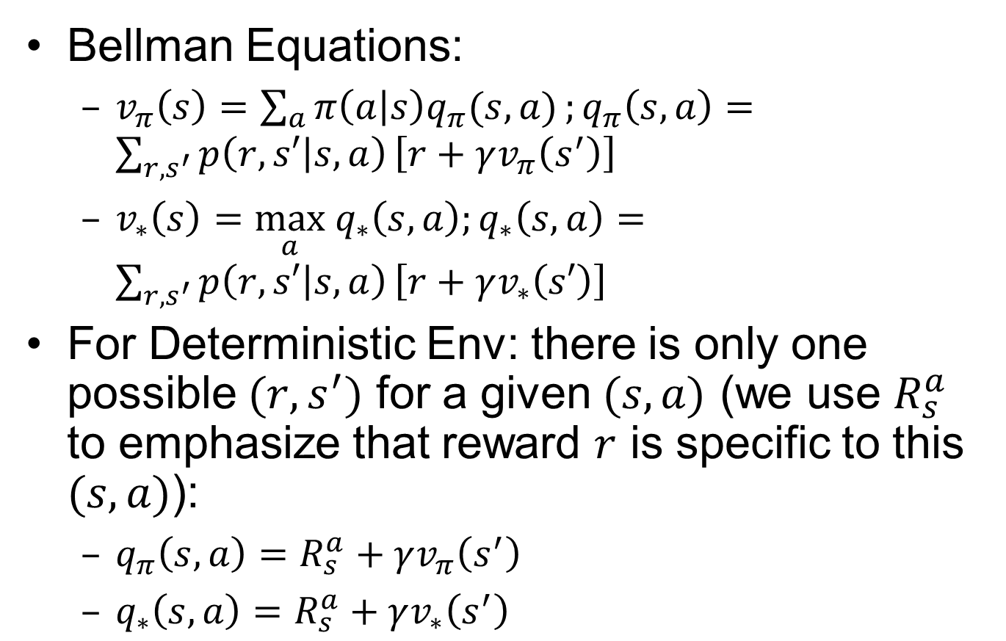
Recall: Simplified Bellman Equations for Deterministic Env
Bellman Equations:
$v_{π}\left(s\right)=\sum_{a}{π\left(a | s\right)q_{π}(s,a)};q_{π}\left(s,a\right)=\sum_{{r, s}^{′}}{p\left(r,s′ | s,a\right)}\left[r+γv_{π}\left(s^{′}\right)\right]$
$v_{∗}\left(s\right)=\max_{a} q_{∗}\left(s,a\right);q_{∗}\left(s,a\right)=\sum_{{r, s}^{′}}{p\left(r,s′ | s,a\right)}\left[r+γv_{∗}\left(s′\right)\right]$
For Deterministic Env: there is only one possible $(r,s^{′})$ for a given $(s,a)$ (we use $R_{s}^{a}$ to emphasize that reward $r$ is specific to this $(s,a)$):
$q_{π}\left(s,a\right)=R_{s}^{a}+γv_{π}\left(s^{′}\right)$
$q_{∗}\left(s,a\right)=R_{s}^{a}+γv_{∗}\left(s^{′}\right)$

Slide 5
Policy Iteration

Slide 6
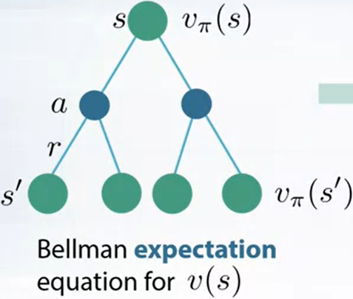
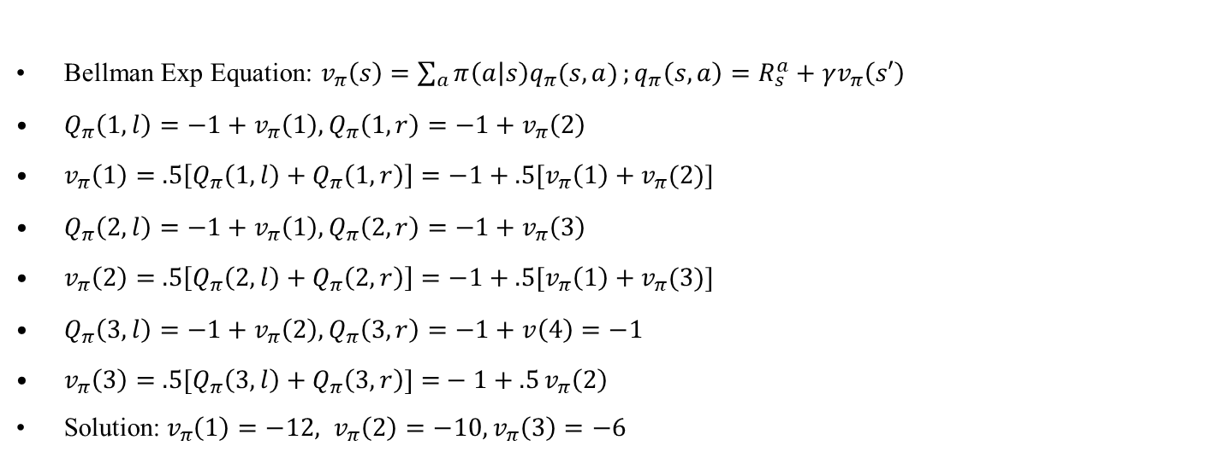
1.1 Policy Evaluation of Random Policy
BF=2
BF=1
Bellman Exp Equation: $v_{π}\left(s\right)=\sum_{a}{π\left(a | s\right)q_{π}(s,a)};q_{π}\left(s,a\right)=R_{s}^{a}+γv_{π}\left(s′\right)$
$Q_{π}\left(1,l\right)=−1+v_{π}\left(1\right),Q_{π}\left(1,r\right)=−1+v_{π}\left(2\right)$
$v_{π}\left(1\right)=$ $.5\left[Q_{π}\left(1,l\right)+Q_{π}\left(1,r\right)\right]=−1+.5[v_{π}\left(1\right)+v_{π}(2)]$
$Q_{π}\left(2,l\right)=−1+v_{π}\left(1\right),Q_{π}\left(2,r\right)=−1+v_{π}\left(3\right)$
$v_{π}\left(2\right)=$ $.5\left[Q_{π}\left(2,l\right)+Q_{π}\left(2,r\right)\right]=−1+.5[v_{π}\left(1\right)+v_{π}(3)]$
$Q_{π}\left(3,l\right)=−1+v_{π}\left(2\right),Q_{π}\left(3,r\right)=−1+v\left(4\right)=−1$
$v_{π}\left(3\right)=$ $.5[Q_{π}\left(3,l\right)+Q_{π}\left(3,r\right)]{=}−1+.5{v_{π}\left(2\right)}$
Solution:$v_{π}\left(1\right)=−12, v_{π}\left(2\right)=−10, v_{π}\left(3\right)=−6$
-12
-10
-6

Slide 7
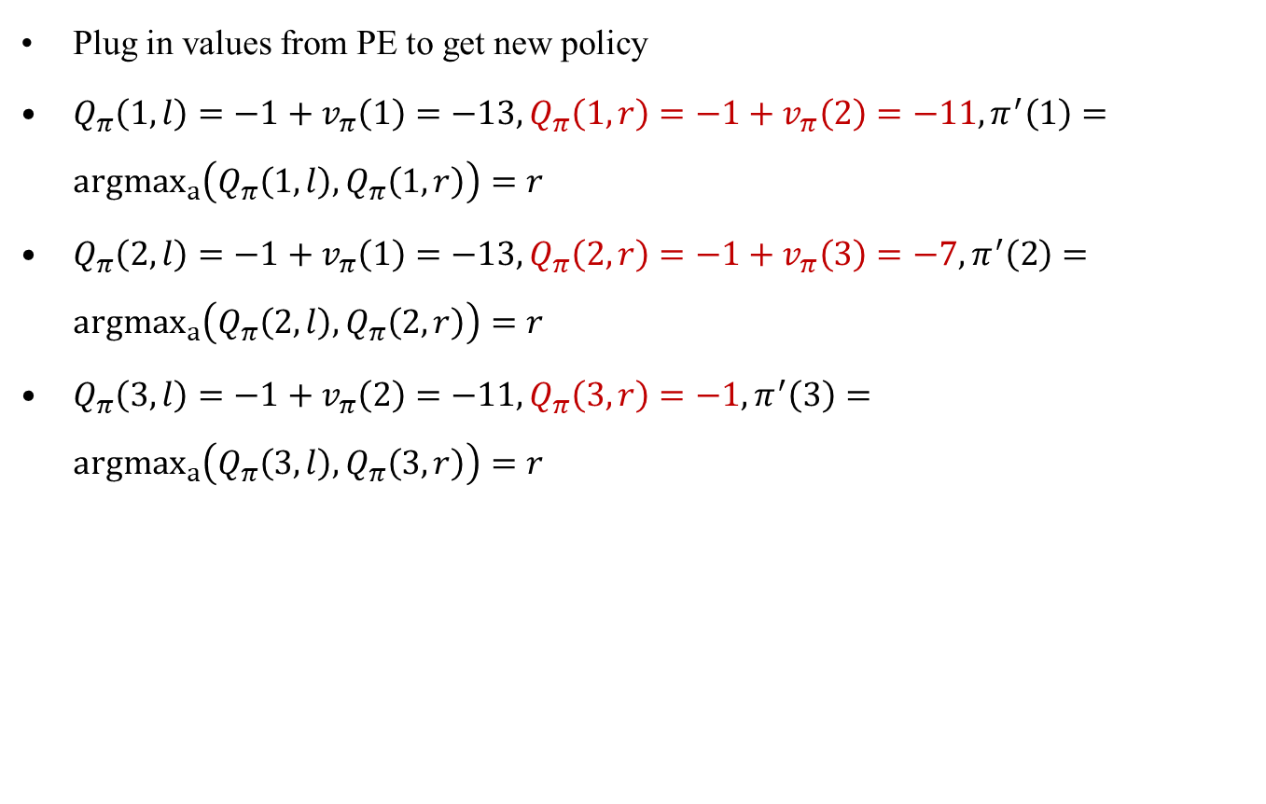
1.2 Policy Improvement
Plug in values from PE to get new policy
$Q_{π}\left(1,l\right)=−1+v_{π}\left(1\right)=−13,Q_{π}\left(1,r\right)=−1+v_{π}\left(2\right)=−11,π^{′}\left(1\right)={argmax}_{a}\left(Q_{π}\left(1,l\right),Q_{π}\left(1,r\right)\right)=r$
$Q_{π}\left(2,l\right)=−1+v_{π}\left(1\right)=−13,Q_{π}\left(2,r\right)=−1+v_{π}\left(3\right)=−7,π^{′}\left(2\right)={argmax}_{a}\left(Q_{π}\left(2,l\right),Q_{π}\left(2,r\right)\right)=r$
$Q_{π}\left(3,l\right)=−1+v_{π}\left(2\right)=−11,Q_{π}\left(3,r\right)=−1,π^{′}\left(3\right)={argmax}_{a}\left(Q_{π}\left(3,l\right),Q_{π}\left(3,r\right)\right)=r$
-12
-10
-6

Slide 8

2.1 Policy Evaluation of Det Policy
BF=1
BF=1
$Q_{π}\left(1,r\right)=−1+v_{π}\left(2\right)$
$v_{π}\left(1\right)=$ $1Q_{π}\left(1,r\right)=−1+v_{π}\left(2\right)$
$Q_{π}\left(2,r\right)=−1+v_{π}\left(3\right)$
$v_{π}\left(2\right)=$ $1Q_{π}\left(2,r\right)=−1+v_{π}\left(3\right)$
$Q_{π}\left(3,r\right)=−1$
$v_{π}\left(3\right)=$ $1Q_{π}\left(3,r\right)=−1$
Solution:$v_{π}\left(1\right)=−3, v_{π}\left(2\right)=−2, v_{π}\left(3\right)=−1$
-3
-2
-1

Slide 9
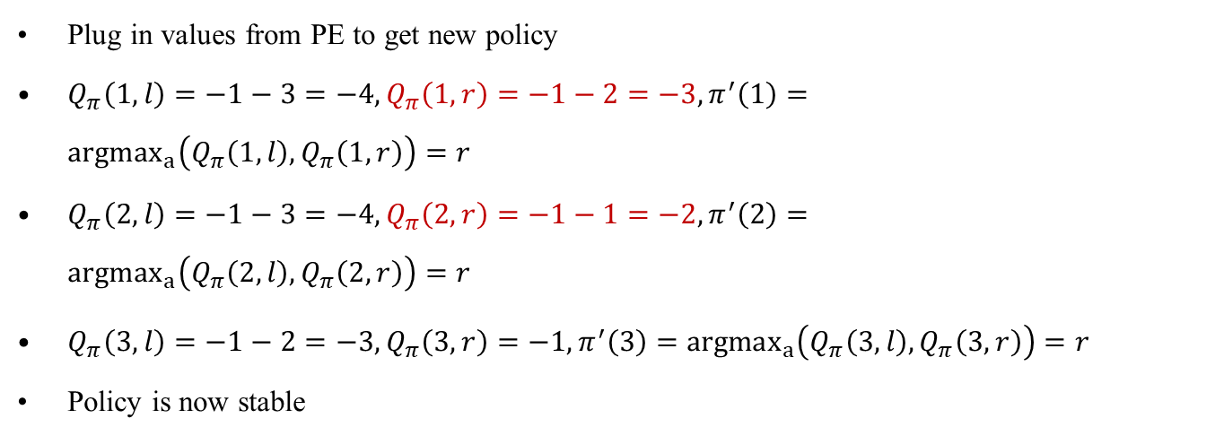
2.2 Policy Improvement
Plug in values from PE to get new policy
$Q_{π}\left(1,l\right)=−1−3=−4,Q_{π}\left(1,r\right)=−1−2=−3,π^{′}\left(1\right)={argmax}_{a}\left(Q_{π}\left(1,l\right),Q_{π}\left(1,r\right)\right)=r$
$Q_{π}\left(2,l\right)=−1−3=−4,Q_{π}\left(2,r\right)=−1−1=−2,π^{′}\left(2\right)={argmax}_{a}\left(Q_{π}\left(2,l\right),Q_{π}\left(2,r\right)\right)=r$
$Q_{π}\left(3,l\right)=−1−2=−3,Q_{π}\left(3,r\right)=−1,π^{′}\left(3\right)={argmax}_{a}\left(Q_{π}\left(3,l\right),Q_{π}\left(3,r\right)\right)=r$
Policy is now stable
-3
-2
-1

Slide 10
Value Iteration

Slide 11
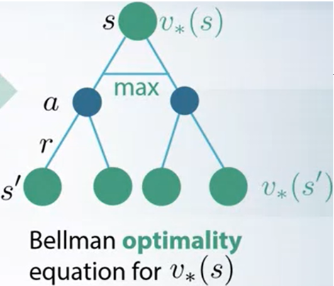
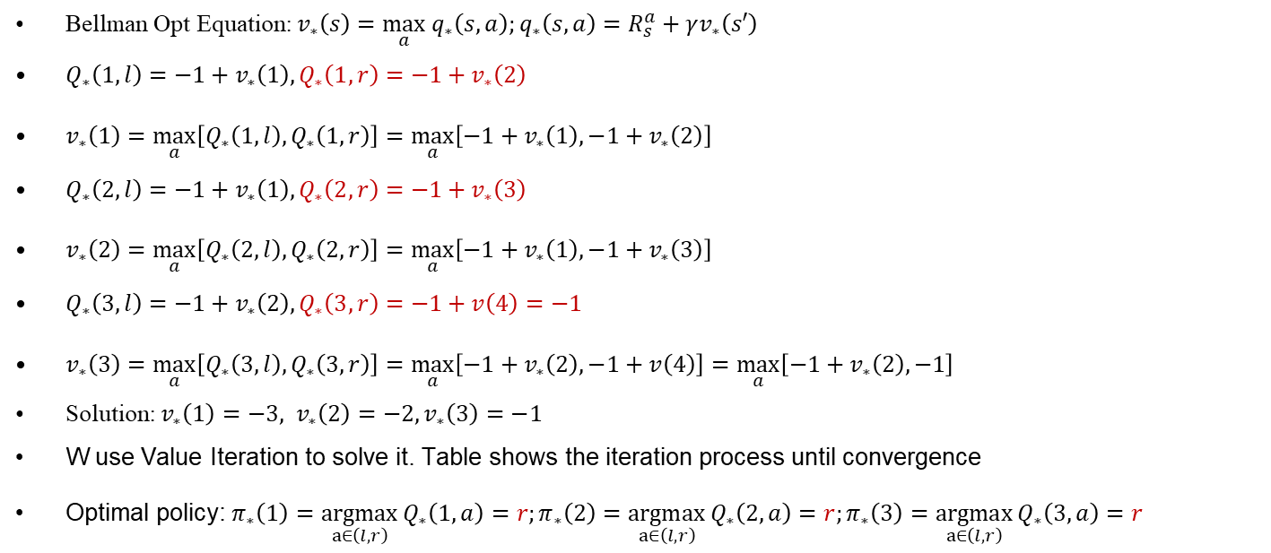
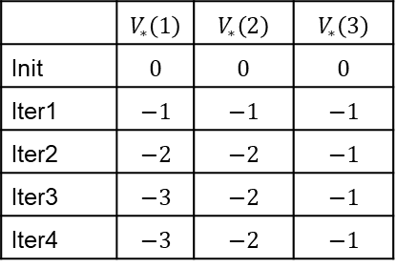
Value Iteration
BF=2
Bellman Opt Equation: $v_{∗}\left(s\right)=\max_{a} q_{∗}\left(s,a\right);q_{∗}\left(s,a\right)=R_{s}^{a}+γv_{∗}\left(s′\right)$
$Q_{∗}\left(1,l\right)=−1+v_{∗}\left(1\right),Q_{∗}\left(1,r\right)=−1+v_{∗}\left(2\right)$
$v_{∗}\left(1\right)=\max_{a}\left[Q_{∗}\left(1,l\right),Q_{∗}\left(1,r\right)\right]=\max_{a}\left[−1+v_{∗}\left(1\right),−1+v_{∗}\left(2\right)\right]$
$Q_{∗}\left(2,l\right)=−1+v_{∗}\left(1\right),Q_{∗}\left(2,r\right)=−1+v_{∗}\left(3\right)$
$v_{∗}\left(2\right)=\max_{a}\left[Q_{∗}\left(2,l\right),Q_{∗}\left(2,r\right)\right]=\max_{a}\left[−1+v_{∗}\left(1\right),−1+v_{∗}\left(3\right)\right]$
$Q_{∗}\left(3,l\right)=−1+v_{∗}\left(2\right),Q_{∗}\left(3,r\right)=−1+v\left(4\right)=−1$
$v_{∗}\left(3\right)=\max_{a}\left[Q_{∗}\left(3,l\right),Q_{∗}\left(3,r\right)\right]=\max_{a}\left[−1+v_{∗}\left(2\right),−1+v\left(4\right)\right]=\max_{a}\left[−1+v_{∗}\left(2\right),−1\right]$
Solution:$v_{∗}\left(1\right)=−3, v_{∗}\left(2\right)=−2, v_{∗}\left(3\right)=−1$
W use Value Iteration to solve it. Table shows the iteration process until convergence
Optimal policy: $π_{∗}\left(1\right)=\underset{a∈\left(l,r\right)}{argmax}{Q_{∗}\left(1,a\right)}=r;π_{∗}\left(2\right)=\underset{a∈\left(l,r\right)}{argmax}{Q_{∗}\left(2,a\right)}=r;π_{∗}\left(3\right)=\underset{a∈\left(l,r\right)}{argmax}{Q_{∗}\left(3,a\right)}=r$
BF=1
 | $$V_{∗}\left(1\right)$$ | $$V_{∗}\left(2\right)$$ | $$V_{∗}\left(3\right)$$
Init | $$0$$ | $$0$$ | $$0$$
Iter1 | $$−1$$ | $$−1$$ | $$−1$$
Iter2 | $$−2$$ | $$−2$$ | $$−1$$
Iter3 | $$−3$$ | $$−2$$ | $$−1$$
Iter4 | $$−3$$ | $$−2$$ | $$−1$$
-3
-2
-1
Notes:
Bellman Opt Equation: $v_{∗}\left(s\right)=$ $\max_{a}{\sum_{r,s^{′}}{p\left(r,s′ | s,a\right)}\left[r+γv_{∗}\left(s^{′}\right)\right]}$
(There is no analytical method for solving nonlinear equations with $\max_{a}$ operator, and you need to . In this case the solution is easy to see by observation, but in general you need to use iterative solving method.)

Slide 12
TD Learning

Slide 13
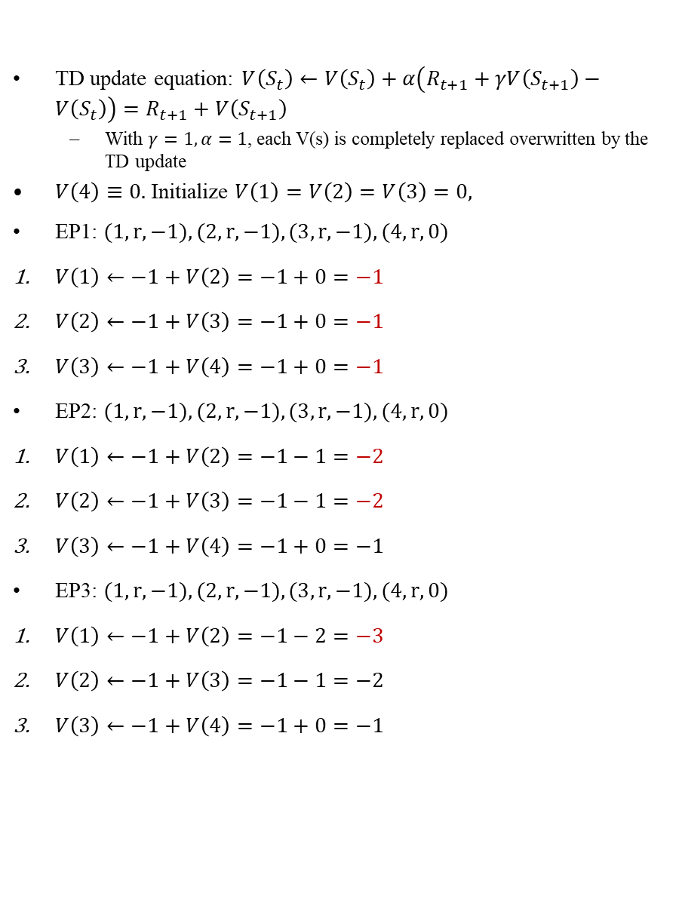
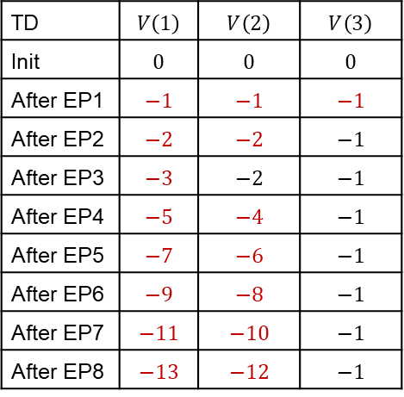
EP1-3
TD update equation: $V\left(S_{t}\right)←V\left(S_{t}\right)+α\left(R_{t+1}+γV\left(S_{t+1}\right)−V\left(S_{t}\right)\right)=R_{t+1}+V\left(S_{t+1}\right)$
With $γ=1, α=1$, each V(s) is completely replaced overwritten by the TD update
$V\left(4\right)≡0.$ Initialize $V\left(1\right)=V\left(2\right)=V\left(3\right)=0,$
EP1: $(1, r, −1),(2, r, −1),(3, r, −1),(4, r, 0)$
$V\left(1\right)←−1+V\left(2\right)=−1+0=−1$
$V\left(2\right)←−1+V\left(3\right)=−1+0=−1$
$V\left(3\right)←−1+V\left(4\right)=−1+0=−1$
EP2: $(1, r, −1),(2, r, −1),(3, r, −1),(4, r, 0)$
$V\left(1\right)←−1+V\left(2\right)=−1−1=−2$
$V\left(2\right)←−1+V\left(3\right)=−1−1=−2$
$V\left(3\right)←−1+V\left(4\right)=−1+0=−1$
EP3: $(1, r, −1),(2, r, −1),(3, r, −1),(4, r, 0)$
$V\left(1\right)←−1+V\left(2\right)=−1−2=−3$
$V\left(2\right)←−1+V\left(3\right)=−1−1=−2$
$V\left(3\right)←−1+V\left(4\right)=−1+0=−1$
TD | $$V\left(1\right)$$ | $$V\left(2\right)$$ | $$V\left(3\right)$$
Init | $$0$$ | $$0$$ | $$0$$
After EP1 | $$−1$$ | $$−1$$ | $$−1$$
After EP2 | $$−2$$ | $$−2$$ | $$−1$$
After EP3 | $$−3$$ | $$−2$$ | $$−1$$
After EP4 | $$−5$$ | $$−4$$ | $$−1$$
After EP5 | $$−7$$ | $$−6$$ | $$−1$$
After EP6 | $$−9$$ | $$−8$$ | $$−1$$
After EP7 | $$−11$$ | $$−10$$ | $$−1$$
After EP8 | $$−13$$ | $$−12$$ | $$−1$$

Slide 14
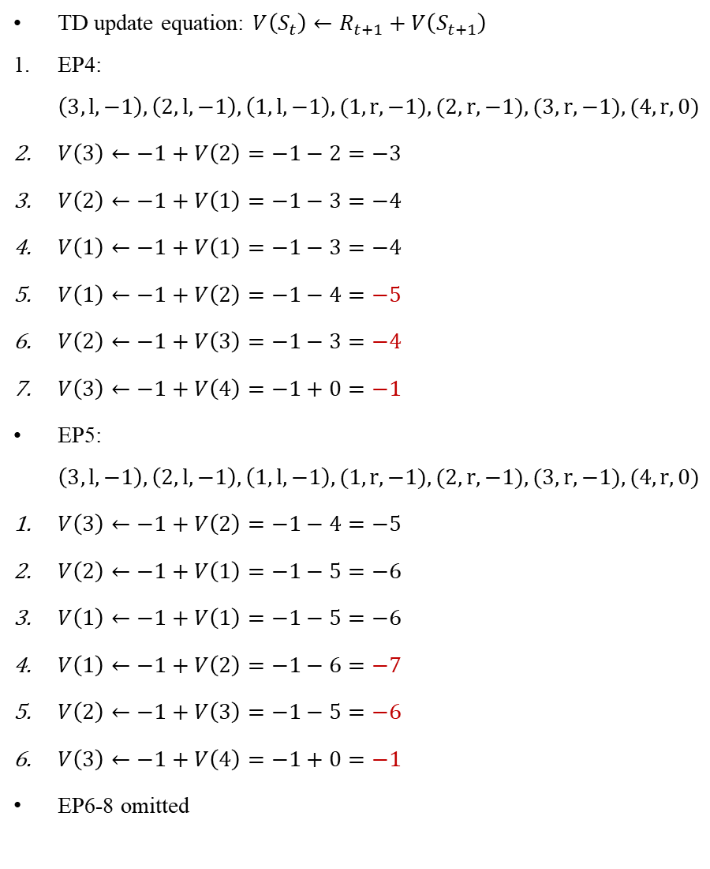
EP4-8
TD update equation: $V\left(S_{t}\right)←R_{t+1}+V\left(S_{t+1}\right)$
EP4: $\left(3, l, −1\right),\left(2, l, −1\right),\left(1,l, −1\right),(1, r, −1),(2, r, −1),(3, r, −1),(4, r, 0)$
$V\left(3\right)←−1+V\left(2\right)=−1−2=−3$
$V\left(2\right)←−1+V\left(1\right)=−1−3=−4$
$V\left(1\right)←−1+V\left(1\right)=−1−3=−4$
$V\left(1\right)←−1+V\left(2\right)=−1−4=−5$
$V\left(2\right)←−1+V\left(3\right)=−1−3=−4$
$V\left(3\right)←−1+V\left(4\right)=−1+0=−1$
EP5: $\left(3, l, −1\right),\left(2, l, −1\right),\left(1,l, −1\right),(1, r, −1),(2, r, −1),(3, r, −1),(4, r, 0)$
$V\left(3\right)←−1+V\left(2\right)=−1−4=−5$
$V\left(2\right)←−1+V\left(1\right)=−1−5=−6$
$V\left(1\right)←−1+V\left(1\right)=−1−5=−6$
$V\left(1\right)←−1+V\left(2\right)=−1−6=−7$
$V\left(2\right)←−1+V\left(3\right)=−1−5=−6$
$V\left(3\right)←−1+V\left(4\right)=−1+0=−1$
EP6-8 omitted
TD | $$V\left(1\right)$$ | $$V\left(2\right)$$ | $$V\left(3\right)$$
Init | $$0$$ | $$0$$ | $$0$$
After EP1 | $$−1$$ | $$−1$$ | $$−1$$
After EP2 | $$−2$$ | $$−2$$ | $$−1$$
After EP3 | $$−3$$ | $$−2$$ | $$−1$$
After EP4 | $$−5$$ | $$−4$$ | $$−1$$
After EP5 | $$−7$$ | $$−6$$ | $$−1$$
After EP6 | $$−9$$ | $$−8$$ | $$−1$$
After EP7 | $$−11$$ | $$−10$$ | $$−1$$
After EP8 | $$−13$$ | $$−12$$ | $$−1$$
Notes:
(overwritten) My comments: TD failed to converge. When moving left, $V\left(3\right)$ bootstraps off $V\left(2\right)$, $V\left(2\right)$ bootstraps off $V\left(1\right)$, and so on. The sequence of TD updates cause all value functions to be increasingly negative. Subsequently, moving right helps to set $V\left(3\right)$ to the correct value of $−1$, but then the episode ends immediately, so $V\left(1\right)$ and $V\left(2\right)$ do not have a chance to bootstrap off the new $V\left(3\right)$. If the episode does not end immediately, but goes back to the left again, then $V\left(1\right)$ and $V\left(2\right)$ will have a chance to bootstrap off the new $V\left(3\right)$, and they will converge to the correct values.
TD cannot be used to learn a policy in the model-free case.

Slide 15
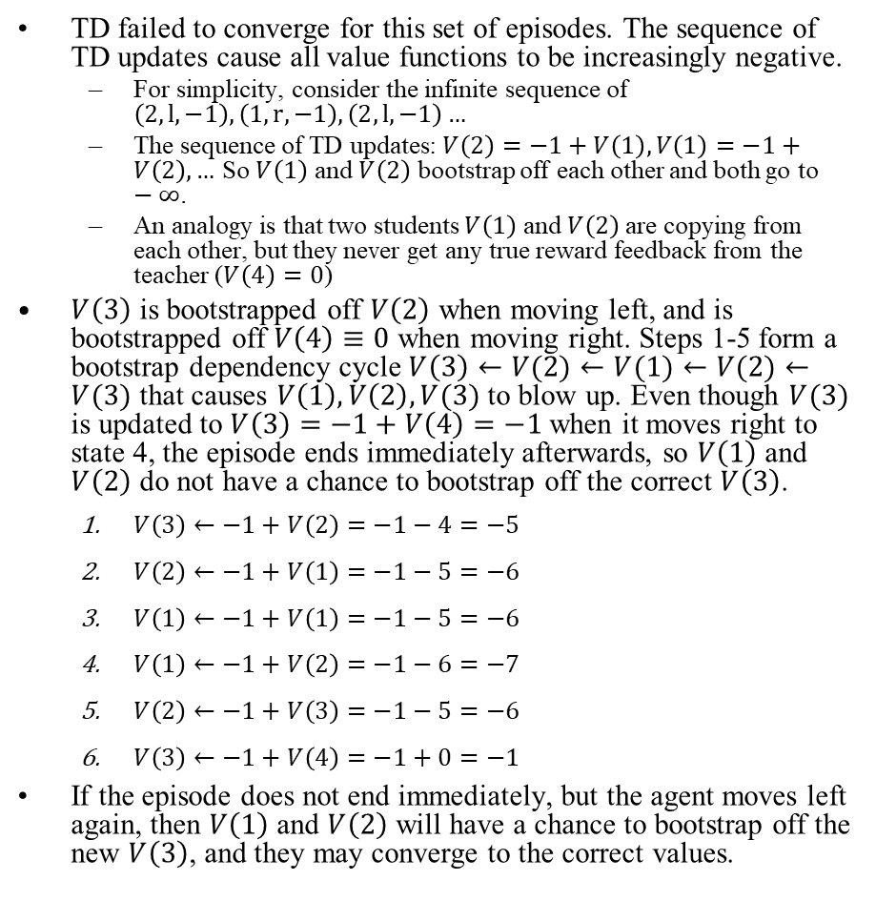
TD failed to converge
TD failed to converge for this set of episodes. The sequence of TD updates cause all value functions to be increasingly negative.
For simplicity, consider the infinite sequence of $\left(2, l, −1\right),\left(1,r, −1\right),\left(2, l, −1\right)…$
The sequence of TD updates: $V\left(2\right)=−1+V\left(1\right),V\left(1\right)=−1+V\left(2\right),…$ So $V\left(1\right)$ and $V\left(2\right)$ bootstrap off each other and both go to $−∞$.
An analogy is that two students $V\left(1\right)$ and $V\left(2\right)$are copying from each other, but they never get any true reward feedback from the teacher ($V\left(4\right)=0$)
$V\left(3\right)$ is bootstrapped off $V\left(2\right)$ when moving left, and is bootstrapped off $V\left(4\right)≡0$ when moving right. Steps 1-5 form a bootstrap dependency cycle $V\left(3\right)←V(2)←V(1)←V(2)←V(3)$ that causes $V\left(1\right),V\left(2\right),V(3)$ to blow up. Even though $V(3)$ is updated to $V\left(3\right)=−1+V\left(4\right)=−1$ when it moves right to state 4, the episode ends immediately afterwards, so $V\left(1\right)$ and $V\left(2\right)$ do not have a chance to bootstrap off the correct $V\left(3\right)$.
$V\left(3\right)←−1+V\left(2\right)=−1−4=−5$
$V\left(2\right)←−1+V\left(1\right)=−1−5=−6$
$V\left(1\right)←−1+V\left(1\right)=−1−5=−6$
$V\left(1\right)←−1+V\left(2\right)=−1−6=−7$
$V\left(2\right)←−1+V\left(3\right)=−1−5=−6$
$V\left(3\right)←−1+V\left(4\right)=−1+0=−1$
If the episode does not end immediately, but the agent moves left again, then $V\left(1\right)$ and $V\left(2\right)$ will have a chance to bootstrap off the new $V\left(3\right)$, and they may converge to the correct values.
TD | $$V\left(1\right)$$ | $$V\left(2\right)$$ | $$V\left(3\right)$$
Init | $$0$$ | $$0$$ | $$0$$
After EP1 | $$−1$$ | $$−1$$ | $$−1$$
After EP2 | $$−2$$ | $$−2$$ | $$−1$$
After EP3 | $$−3$$ | $$−2$$ | $$−1$$
After EP4 | $$−5$$ | $$−4$$ | $$−1$$
After EP5 | $$−7$$ | $$−6$$ | $$−1$$
After EP6 | $$−9$$ | $$−8$$ | $$−1$$
After EP7 | $$−11$$ | $$−10$$ | $$−1$$
After EP8 | $$−13$$ | $$−12$$ | $$−1$$

Slide 16
Sarsa

Slide 17
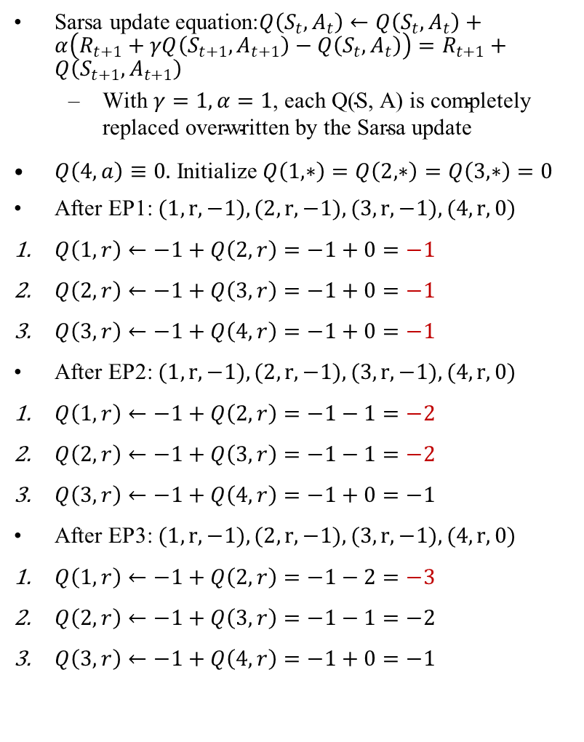
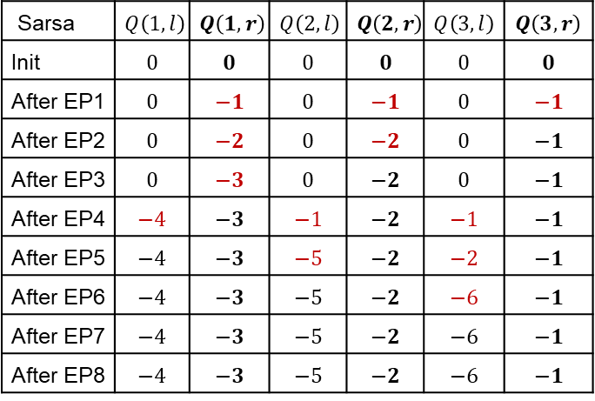
EP1-3
Sarsa update equation:$Q\left(S_{t},A_{t}\right)←Q\left(S_{t},A_{t}\right)+α\left(R_{t+1}+γQ\left(S_{t+1},A_{t+1}\right)−Q\left(S_{t},A_{t}\right)\right)=R_{t+1}+Q\left(S_{t+1},A_{t+1}\right)$
$\text{With} γ=1, α=1\text{, }\text{each} \text{Q}\text{(}\text{S}\text{, }\text{A}\text{) }\text{is} \text{completely} \text{replaced} \text{overwritten} \text{by} \text{the} \text{Sarsa} \text{update}$
$Q\left(4,a\right)≡0.$ Initialize $Q\left(1,∗\right)=Q\left(2,∗\right)=Q\left(3,∗\right)=0$
After EP1: $(1, r, −1),(2, r, −1),(3, r, −1),(4, r, 0)$
$Q\left(1,r\right)←−1+Q\left(2,r\right)=−1+0=−1$
$Q\left(2,r\right)←−1+Q\left(3,r\right)=−1+0=−1$
$Q\left(3,r\right)←−1+Q\left(4,r\right)=−1+0=−1$
After EP2: $(1, r, −1),(2, r, −1),(3, r, −1),(4, r, 0)$
$Q\left(1,r\right)←−1+Q\left(2,r\right)=−1−1=−2$
$Q\left(2,r\right)←−1+Q\left(3,r\right)=−1−1=−2$
$Q\left(3,r\right)←−1+Q\left(4,r\right)=−1+0=−1$
After EP3: $(1, r, −1),(2, r, −1),(3, r, −1),(4, r, 0)$
$Q\left(1,r\right)←−1+Q\left(2,r\right)=−1−2=−3$
$Q\left(2,r\right)←−1+Q\left(3,r\right)=−1−1=−2$
$Q\left(3,r\right)←−1+Q\left(4,r\right)=−1+0=−1$
Sarsa | $$Q\left(1,l\right)$$ | $$Q\left(1,r\right)$$ | $$Q\left(2,l\right)$$ | $$Q\left(2,r\right)$$ | $$Q\left(3,l\right)$$ | $$Q\left(3,r\right)$$
Init | $$0$$ | $$0$$ | $$0$$ | $$0$$ | $$0$$ | $$0$$
After EP1 | $$0$$ | $$−1$$ | $$0$$ | $$−1$$ | $$0$$ | $$−1$$
After EP2 | $$0$$ | $$−2$$ | $$0$$ | $$−2$$ | $$0$$ | $$−1$$
After EP3 | $$0$$ | $$−3$$ | $$0$$ | $$−2$$ | $$0$$ | $$−1$$
After EP4 | $$−4$$ | $$−3$$ | $$−1$$ | $$−2$$ | $$−1$$ | $$−1$$
After EP5 | $$−4$$ | $$−3$$ | $$−5$$ | $$−2$$ | $$−2$$ | $$−1$$
After EP6 | $$−4$$ | $$−3$$ | $$−5$$ | $$−2$$ | $$−6$$ | $$−1$$
After EP7 | $$−4$$ | $$−3$$ | $$−5$$ | $$−2$$ | $$−6$$ | $$−1$$
After EP8 | $$−4$$ | $$−3$$ | $$−5$$ | $$−2$$ | $$−6$$ | $$−1$$

Slide 18
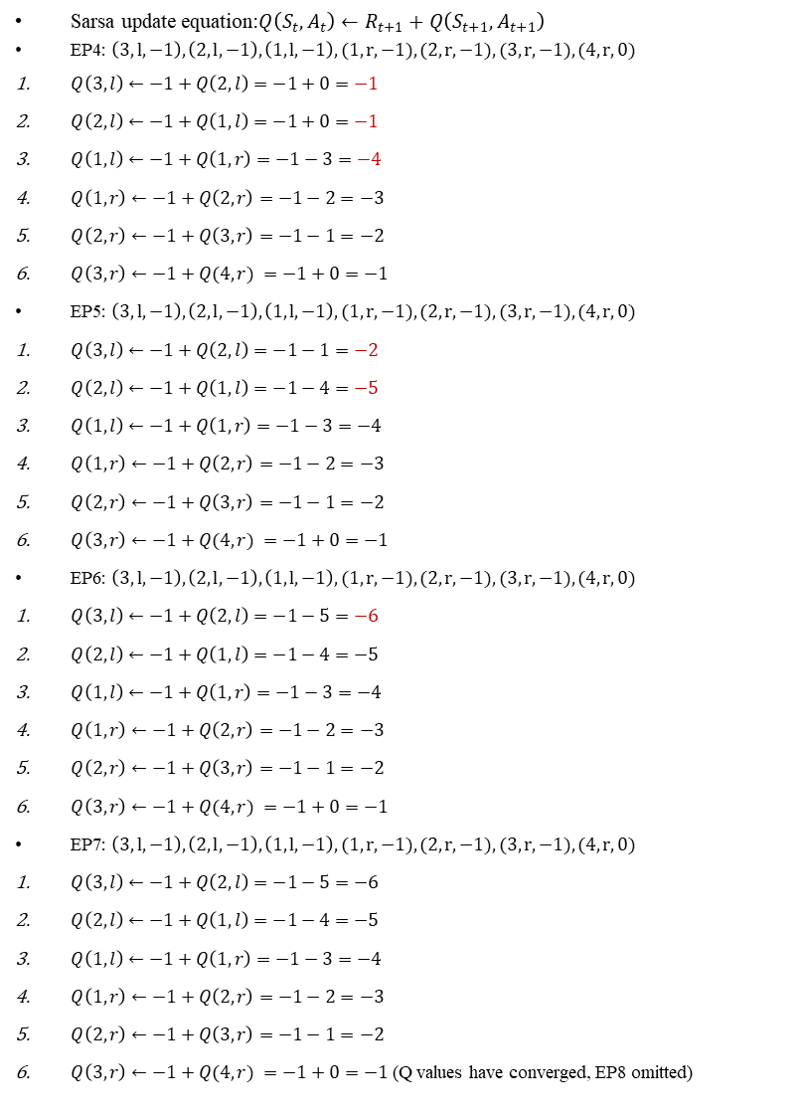
EP4-8
Sarsa update equation:$Q\left(S_{t},A_{t}\right)←R_{t+1}+Q\left(S_{t+1},A_{t+1}\right)$
EP4: $\left(3, l, −1\right),\left(2, l, −1\right),\left(1,l, −1\right),(1, r, −1),(2, r, −1),(3, r, −1),(4, r, 0)$
$Q\left(3,l\right)←−1+Q\left(2,l\right)=−1+0=−1$
$Q\left(2,l\right)←−1+Q\left(1,l\right)=−1+0=−1$
$Q\left(1,l\right)←−1+Q\left(1,r\right)=−1−3=−4$
$Q\left(1,r\right)←−1+Q\left(2,r\right)=−1−2=−3$
$Q\left(2,r\right)←−1+Q\left(3,r\right)=−1−1=−2$
$Q\left(3,r\right)←−1+Q(4,r) =−1+0=−1$
EP5: $\left(3, l, −1\right),\left(2, l, −1\right),\left(1,l, −1\right),(1, r, −1),(2, r, −1),(3, r, −1),(4, r, 0)$
$Q\left(3,l\right)←−1+Q\left(2,l\right)=−1−1=−2$
$Q\left(2,l\right)←−1+Q\left(1,l\right)=−1−4=−5$
$Q\left(1,l\right)←−1+Q\left(1,r\right)=−1−3=−4$
$Q\left(1,r\right)←−1+Q\left(2,r\right)=−1−2=−3$
$Q\left(2,r\right)←−1+Q\left(3,r\right)=−1−1=−2$
$Q\left(3,r\right)←−1+Q(4,r) =−1+0=−1$
EP6: $\left(3, l, −1\right),\left(2, l, −1\right),\left(1,l, −1\right),(1, r, −1),(2, r, −1),(3, r, −1),(4, r, 0)$
$Q\left(3,l\right)←−1+Q\left(2,l\right)=−1−5=−6$
$Q\left(2,l\right)←−1+Q\left(1,l\right)=−1−4=−5$
$Q\left(1,l\right)←−1+Q\left(1,r\right)=−1−3=−4$
$Q\left(1,r\right)←−1+Q\left(2,r\right)=−1−2=−3$
$Q\left(2,r\right)←−1+Q\left(3,r\right)=−1−1=−2$
$Q\left(3,r\right)←−1+Q(4,r) =−1+0=−1$
EP7: $\left(3, l, −1\right),\left(2, l, −1\right),\left(1,l, −1\right),(1, r, −1),(2, r, −1),(3, r, −1),(4, r, 0)$
$Q\left(3,l\right)←−1+Q\left(2,l\right)=−1−5=−6$
$Q\left(2,l\right)←−1+Q\left(1,l\right)=−1−4=−5$
$Q\left(1,l\right)←−1+Q\left(1,r\right)=−1−3=−4$
$Q\left(1,r\right)←−1+Q\left(2,r\right)=−1−2=−3$
$Q\left(2,r\right)←−1+Q\left(3,r\right)=−1−1=−2$
$Q\left(3,r\right)←−1+Q(4,r) =−1+0=−1$ (Q values have converged, EP8 omitted)
Sarsa | $$Q\left(1,l\right)$$ | $$Q\left(1,r\right)$$ | $$Q\left(2,l\right)$$ | $$Q\left(2,r\right)$$ | $$Q\left(3,l\right)$$ | $$Q\left(3,r\right)$$
Init | $$0$$ | $$0$$ | $$0$$ | $$0$$ | $$0$$ | $$0$$
After EP1 | $$0$$ | $$−1$$ | $$0$$ | $$−1$$ | $$0$$ | $$−1$$
After EP2 | $$0$$ | $$−2$$ | $$0$$ | $$−2$$ | $$0$$ | $$−1$$
After EP3 | $$0$$ | $$−3$$ | $$0$$ | $$−2$$ | $$0$$ | $$−1$$
After EP4 | $$−4$$ | $$−3$$ | $$−1$$ | $$−2$$ | $$−1$$ | $$−1$$
After EP5 | $$−4$$ | $$−3$$ | $$−5$$ | $$−2$$ | $$−2$$ | $$−1$$
After EP6 | $$−4$$ | $$−3$$ | $$−5$$ | $$−2$$ | $$−6$$ | $$−1$$
After EP7 | $$−4$$ | $$−3$$ | $$−5$$ | $$−2$$ | $$−6$$ | $$−1$$
After EP8 | $$−4$$ | $$−3$$ | $$−5$$ | $$−2$$ | $$−6$$ | $$−1$$
Notes:
(bootstraps off $Q\left(1,r\right)$)
$Q\left(2,l\right)←Q\left(2,l\right)+1\left(−1+Q(1,l)−Q\left(2,l\right)\right)=−1+1\left(−1−4+1\right)=−5$(bootstraps off $Q\left(1,l\right)$)
$Q\left(3,l\right)←Q\left(3,l\right)+1\left(−1+Q\left(2,l\right)−Q\left(3,l\right)\right)=−2+1\left(−1−5+2\right)=−6$ (bootstraps off $Q\left(2,l\right)$)

Slide 19
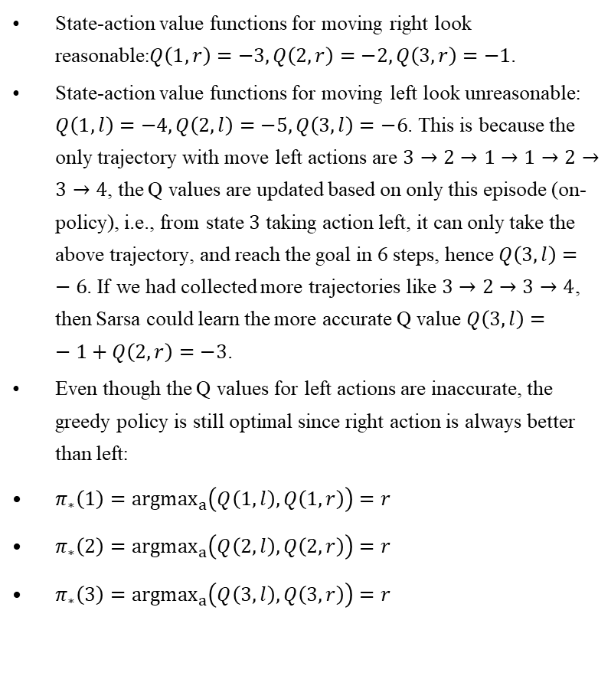
Comments on Sarsa
State-action value functions for moving right look reasonable:$Q\left(1,r\right)=−3,Q\left(2,r\right)=−2,Q\left(3,r\right)=−1$.
State-action value functions for moving left look unreasonable: $Q\left(1,l\right)=−4,Q\left(2,l\right)=−5,Q\left(3,l\right)=−6$. This is because the only trajectory with move left actions are $3→2→1→1→2→3→4$, the Q values are updated based on only this episode (on-policy), i.e., from state $3$ taking action left, it can only take the above trajectory, and reach the goal in 6 steps, hence $Q\left(3,l\right)=−6$. If we had collected more trajectories like $3→2→3→4$, then Sarsa could learn the more accurate Q value $Q\left(3,l\right)=−1+Q\left(2,r\right)=−3$.
Even though the Q values for left actions are inaccurate, the greedy policy is still optimal since right action is always better than left:
$π_{∗}\left(1\right)={argmax}_{a}\left(Q\left(1,l\right),Q\left(1,r\right)\right)=r$
$π_{∗}\left(2\right)={argmax}_{a}\left(Q\left(2,l\right),Q\left(2,r\right)\right)=r$
$π_{∗}\left(3\right)={argmax}_{a}\left(Q\left(3,l\right),Q\left(3,r\right)\right)=r$
Sarsa | $$Q\left(1,l\right)$$ | $$Q\left(1,r\right)$$ | $$Q\left(2,l\right)$$ | $$Q\left(2,r\right)$$ | $$Q\left(3,l\right)$$ | $$Q\left(3,r\right)$$
Init | $$0$$ | $$0$$ | $$0$$ | $$0$$ | $$0$$ | $$0$$
After EP1 | $$0$$ | $$−1$$ | $$0$$ | $$−1$$ | $$0$$ | $$−1$$
After EP2 | $$0$$ | $$−2$$ | $$0$$ | $$−2$$ | $$0$$ | $$−1$$
After EP3 | $$0$$ | $$−3$$ | $$0$$ | $$−2$$ | $$0$$ | $$−1$$
After EP4 | $$−4$$ | $$−3$$ | $$−1$$ | $$−2$$ | $$−1$$ | $$−1$$
After EP5 | $$−4$$ | $$−3$$ | $$−5$$ | $$−2$$ | $$−2$$ | $$−1$$
After EP6 | $$−4$$ | $$−3$$ | $$−5$$ | $$−2$$ | $$−6$$ | $$−1$$
After EP7 | $$−4$$ | $$−3$$ | $$−5$$ | $$−2$$ | $$−6$$ | $$−1$$
After EP8 | $$−4$$ | $$−3$$ | $$−5$$ | $$−2$$ | $$−6$$ | $$−1$$

Slide 20
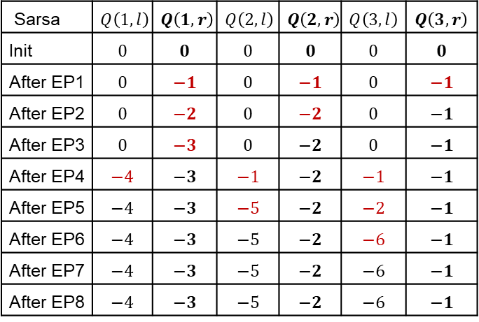
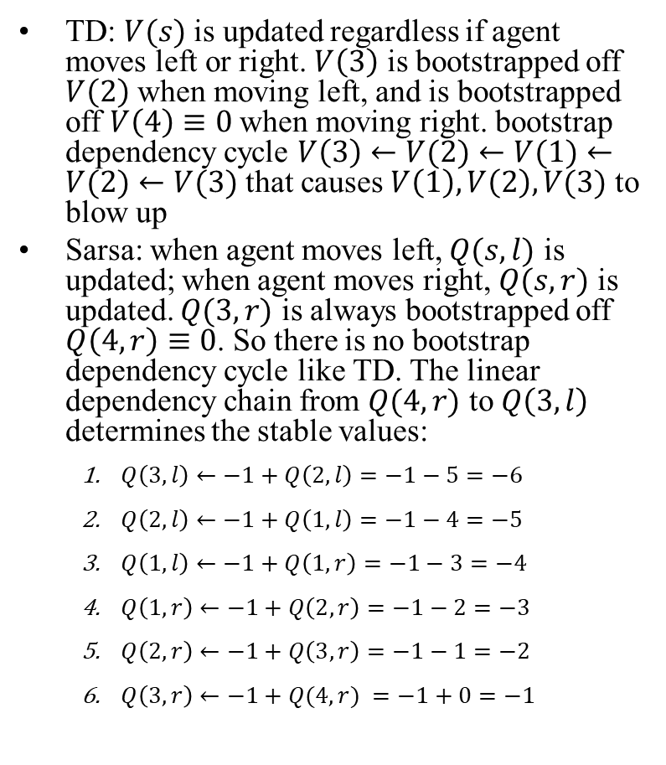
Why Sarsa did not blow up
TD: $V(s)$ is updated regardless if agent moves left or right. $V\left(3\right)$ is bootstrapped off $V\left(2\right)$ when moving left, and is bootstrapped off $V\left(4\right)≡0$ when moving right. bootstrap dependency cycle $V\left(3\right)←V(2)←V(1)←V(2)←V(3)$ that causes $V\left(1\right),V\left(2\right),V(3)$ to blow up
Sarsa: when agent moves left, $Q(s,l)$ is updated; when agent moves right, $Q(s,r)$ is updated. $Q(3,r)$ is always bootstrapped off $Q\left(4,r\right)≡0$. So there is no bootstrap dependency cycle like TD. The linear dependency chain from $Q(4,r)$ to $Q\left(3,l\right)$ determines the stable values:
$Q\left(3,l\right)←−1+Q\left(2,l\right)=−1−5=−6$
$Q\left(2,l\right)←−1+Q\left(1,l\right)=−1−4=−5$
$Q\left(1,l\right)←−1+Q\left(1,r\right)=−1−3=−4$
$Q\left(1,r\right)←−1+Q\left(2,r\right)=−1−2=−3$
$Q\left(2,r\right)←−1+Q\left(3,r\right)=−1−1=−2$
$Q\left(3,r\right)←−1+Q(4,r) =−1+0=−1$
Sarsa | $$Q\left(1,l\right)$$ | $$Q\left(1,r\right)$$ | $$Q\left(2,l\right)$$ | $$Q\left(2,r\right)$$ | $$Q\left(3,l\right)$$ | $$Q\left(3,r\right)$$
Init | $$0$$ | $$0$$ | $$0$$ | $$0$$ | $$0$$ | $$0$$
After EP1 | $$0$$ | $$−1$$ | $$0$$ | $$−1$$ | $$0$$ | $$−1$$
After EP2 | $$0$$ | $$−2$$ | $$0$$ | $$−2$$ | $$0$$ | $$−1$$
After EP3 | $$0$$ | $$−3$$ | $$0$$ | $$−2$$ | $$0$$ | $$−1$$
After EP4 | $$−4$$ | $$−3$$ | $$−1$$ | $$−2$$ | $$−1$$ | $$−1$$
After EP5 | $$−4$$ | $$−3$$ | $$−5$$ | $$−2$$ | $$−2$$ | $$−1$$
After EP6 | $$−4$$ | $$−3$$ | $$−5$$ | $$−2$$ | $$−6$$ | $$−1$$
After EP7 | $$−4$$ | $$−3$$ | $$−5$$ | $$−2$$ | $$−6$$ | $$−1$$
After EP8 | $$−4$$ | $$−3$$ | $$−5$$ | $$−2$$ | $$−6$$ | $$−1$$

Slide 21
Q Learning

Slide 22
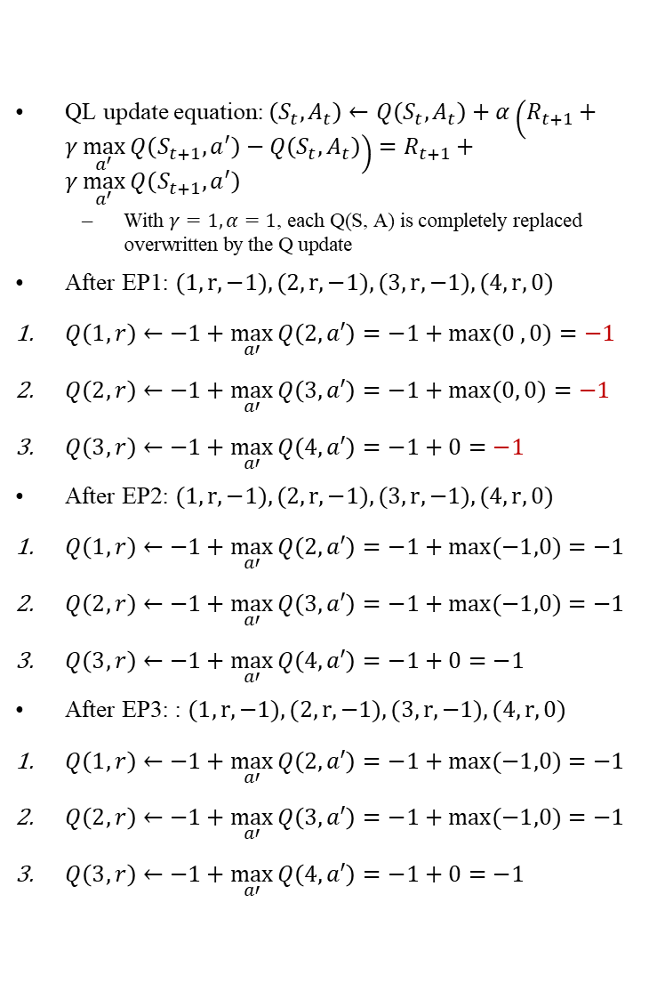
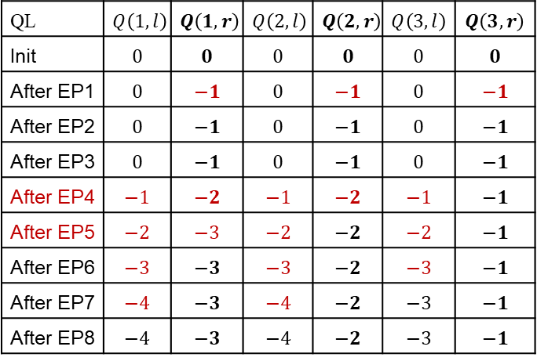
EP1-3
QL update equation: $\left(S_{t},A_{t}\right)←Q\left(S_{t},A_{t}\right)+α\left(R_{t+1}+γ\max_{a^{′}}{Q\left(S_{t+1},a^{′}\right)}−Q\left(S_{t},A_{t}\right)\right)=R_{t+1}+γ\max_{a^{′}}{Q\left(S_{t+1},a^{′}\right)}$
$\text{With} γ=1, α=1\text{, }\text{each} \text{Q}\text{(}\text{S}\text{, }\text{A}\text{) }\text{is} \text{completely} \text{replaced} \text{overwritten} \text{by} \text{the} \text{Q} \text{update}$
After EP1: $(1, r, −1),(2, r, −1),(3, r, −1),(4, r, 0)$
$Q\left(1,r\right)←−1+\max_{a′}{Q\left(2,a′\right)}=−1+\max{(0 ,0)}=−1$
$Q\left(2,r\right)←−1+\max_{a′}{Q\left(3,a′\right)}=−1+\max{(0, 0)}=−1$
$Q\left(3,r\right)←−1+\max_{a′}{Q\left(4,a′\right)}=−1+0=−1$
After EP2: $(1, r, −1),(2, r, −1),(3, r, −1),(4, r, 0)$
$Q\left(1,r\right)←−1+\max_{a′}{Q\left(2,a′\right)}=−1+\max{(−1,0)}=−1$
$Q\left(2,r\right)←−1+\max_{a′}{Q\left(3,a′\right)}=−1+\max{(−1,0)}=−1$
$Q\left(3,r\right)←−1+\max_{a′}{Q\left(4,a′\right)}=−1+0=−1$
After EP3: : $(1, r, −1),(2, r, −1),(3, r, −1),(4, r, 0)$
$Q\left(1,r\right)←−1+\max_{a′}{Q\left(2,a′\right)}=−1+\max{(−1,0)}=−1$
$Q\left(2,r\right)←−1+\max_{a′}{Q\left(3,a′\right)}=−1+\max{(−1,0)}=−1$
$Q\left(3,r\right)←−1+\max_{a′}{Q\left(4,a′\right)}=−1+0=−1$
QL | $$Q\left(1,l\right)$$ | $$Q\left(1,r\right)$$ | $$Q\left(2,l\right)$$ | $$Q\left(2,r\right)$$ | $$Q\left(3,l\right)$$ | $$Q\left(3,r\right)$$
Init | $$0$$ | $$0$$ | $$0$$ | $$0$$ | $$0$$ | $$0$$
After EP1 | $$0$$ | $$−1$$ | $$0$$ | $$−1$$ | $$0$$ | $$−1$$
After EP2 | $$0$$ | $$−1$$ | $$0$$ | $$−1$$ | $$0$$ | $$−1$$
After EP3 | $$0$$ | $$−1$$ | $$0$$ | $$−1$$ | $$0$$ | $$−1$$
After EP4 | $$−1$$ | $$−2$$ | $$−1$$ | $$−2$$ | $$−1$$ | $$−1$$
After EP5 | $$−2$$ | $$−3$$ | $$−2$$ | $$−2$$ | $$−2$$ | $$−1$$
After EP6 | $$−3$$ | $$−3$$ | $$−3$$ | $$−2$$ | $$−3$$ | $$−1$$
After EP7 | $$−4$$ | $$−3$$ | $$−4$$ | $$−2$$ | $$−3$$ | $$−1$$
After EP8 | $$−4$$ | $$−3$$ | $$−4$$ | $$−2$$ | $$−3$$ | $$−1$$
Notes:
After first 3 episodes, $Q\left(1,r\right)=Q\left(2,r\right)=Q\left(3,r\right)=−1$. This is reasonable for $Q\left(3,r\right)$, but not reasonable for $Q\left(1,r\right), Q\left(2,r\right)$, as agent cannot reach goal in one step from states $1$ or $2$. This is because the agent has never taken the left action, so all $Q\left(s,r\right)$ value functions bootstrap off the optimistic initial estimate of $Q\left(s,l\right)=0$, which is wrong and not yet corrected

Slide 23
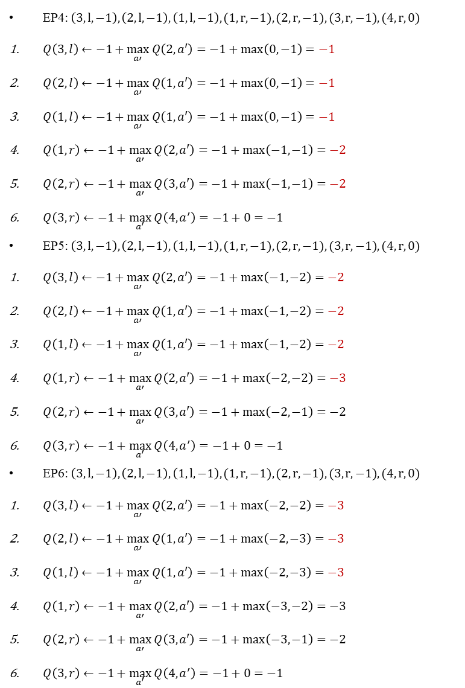
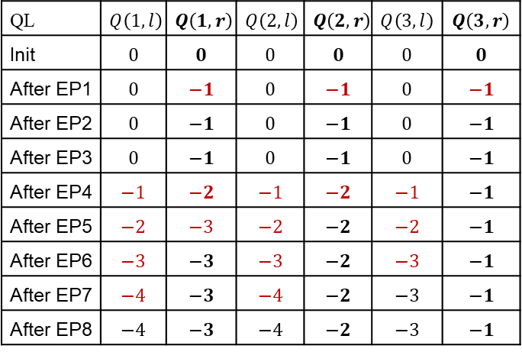
EP4-6
EP4: $\left(3, l, −1\right),\left(2, l, −1\right),\left(1,l, −1\right),(1, r, −1),(2, r, −1),(3, r, −1),(4, r, 0)$
$Q\left(3,l\right)←−1+\max_{a′}{Q\left(2,a′\right)}=−1+\max\left(0,−1\right)=−1$
$Q\left(2,l\right)←−1+\max_{a′}{Q\left(1,a′\right)}=−1+\max\left(0,−1\right)=−1$
$Q\left(1,l\right)←−1+\max_{a′}{Q\left(1,a′\right)}=−1+\max\left(0, −1\right)=−1$
$Q\left(1,r\right)←−1+\max_{a′}{Q\left(2,a′\right)}=−1+\max\left(−1,−1\right)=−2$
$Q\left(2,r\right)←−1+\max_{a′}{Q\left(3,a′\right)}=−1+\max\left(−1,−1\right)=−2$
$Q\left(3,r\right)←−1+\max_{a^{′}}{Q\left(4,a^{′}\right)}=−1+0=−1$
EP5: $\left(3, l, −1\right),\left(2, l, −1\right),\left(1,l, −1\right),(1, r, −1),(2, r, −1),(3, r, −1),(4, r, 0)$
$Q\left(3,l\right)←−1+\max_{a′}{Q\left(2,a′\right)}=−1+\max\left(−1,−2\right)=−2$
$Q\left(2,l\right)←−1+\max_{a′}{Q\left(1,a′\right)}=−1+\max\left(−1,−2\right)=−2$
$Q\left(1,l\right)←−1+\max_{a′}{Q\left(1,a′\right)}=−1+\max\left(−1,−2\right)=−2$
$Q\left(1,r\right)←−1+\max_{a′}{Q\left(2,a′\right)}=−1+\max\left(−2,−2\right)=−3$
$Q\left(2,r\right)←−1+\max_{a′}{Q\left(3,a′\right)}=−1+\max\left(−2,−1\right)=−2$
$Q\left(3,r\right)←−1+\max_{a^{′}}{Q\left(4,a^{′}\right)}=−1+0=−1$
EP6: $\left(3, l, −1\right),\left(2, l, −1\right),\left(1,l, −1\right),(1, r, −1),(2, r, −1),(3, r, −1),(4, r, 0)$
$Q\left(3,l\right)←−1+\max_{a′}{Q\left(2,a′\right)}=−1+\max\left(−2,−2\right)=−3$
$Q\left(2,l\right)←−1+\max_{a′}{Q\left(1,a′\right)}=−1+\max\left(−2,−3\right)=−3$
$Q\left(1,l\right)←−1+\max_{a′}{Q\left(1,a′\right)}=−1+\max\left(−2,−3\right)=−3$
$Q\left(1,r\right)←−1+\max_{a′}{Q\left(2,a′\right)}=−1+\max\left(−3,−2\right)=−3$
$Q\left(2,r\right)←−1+\max_{a′}{Q\left(3,a′\right)}=−1+\max\left(−3,−1\right)=−2$
$Q\left(3,r\right)←−1+\max_{a^{′}}{Q\left(4,a^{′}\right)}=−1+0=−1$
QL | $$Q\left(1,l\right)$$ | $$Q\left(1,r\right)$$ | $$Q\left(2,l\right)$$ | $$Q\left(2,r\right)$$ | $$Q\left(3,l\right)$$ | $$Q\left(3,r\right)$$
Init | $$0$$ | $$0$$ | $$0$$ | $$0$$ | $$0$$ | $$0$$
After EP1 | $$0$$ | $$−1$$ | $$0$$ | $$−1$$ | $$0$$ | $$−1$$
After EP2 | $$0$$ | $$−1$$ | $$0$$ | $$−1$$ | $$0$$ | $$−1$$
After EP3 | $$0$$ | $$−1$$ | $$0$$ | $$−1$$ | $$0$$ | $$−1$$
After EP4 | $$−1$$ | $$−2$$ | $$−1$$ | $$−2$$ | $$−1$$ | $$−1$$
After EP5 | $$−2$$ | $$−3$$ | $$−2$$ | $$−2$$ | $$−2$$ | $$−1$$
After EP6 | $$−3$$ | $$−3$$ | $$−3$$ | $$−2$$ | $$−3$$ | $$−1$$
After EP7 | $$−4$$ | $$−3$$ | $$−4$$ | $$−2$$ | $$−3$$ | $$−1$$
After EP8 | $$−4$$ | $$−3$$ | $$−4$$ | $$−2$$ | $$−3$$ | $$−1$$
Notes:
EP6
$Q\left(3,l\right)←Q\left(3,l\right)+1\left(−1+\max_{a′}{Q\left(2,a′\right)}−Q\left(3,l\right)\right)=−2+1\left(−1+\max\left(−2,−2\right)+2\right)=−3$ (bootstraps off $Q\left(2,l\right)=−2$,$Q\left(2,r\right)=−2$.)
$Q\left(2,l\right)←Q\left(2,l\right)+1\left(−1+\max_{a′}{Q\left(1,a′\right)}−Q\left(2,l\right)\right)=−2+1\left(−1+\max\left(−2,−2\right)+2\right)=−3$(bootstraps off $Q\left(1,l\right)=−2$,$Q\left(1,r\right)=−2$.)
$Q\left(1,l\right)←Q\left(1,l\right)+1\left(−1+\max_{a′}{Q\left(1,a′\right)}−Q\left(1,l\right)\right)=−2+1\left(−1+\max\left(−2,−2\right)+2\right)=−3$ (bootstraps off $Q\left(1,l\right)=−2$,$Q\left(1,r\right)=−2$.)
$Q\left(1,r\right)←Q\left(1,r\right)+1\left(−1+\max_{a′}{Q\left(2,a′\right)}−Q\left(1,r\right)\right)=−2+1\left(−1+\max\left(−2,−2\right)+2\right)=−3$ (bootstraps off $Q\left(2,l\right)=−2$,$Q\left(2,r\right)=−2$)
EP5
$Q\left(3,l\right)←Q\left(3,l\right)+1\left(−1+\max_{a′}{Q\left(2,a′\right)}−Q\left(3,l\right)\right)=−1+1\left(−1+\max\left(−1,−2\right)+1\right)=−2$ (bootstraps off $Q\left(2,l\right)=−1$,$Q\left(2,r\right)=−2$.)
$Q\left(2,l\right)←Q\left(2,l\right)+1\left(−1+\max_{a′}{Q\left(1,a′\right)}−Q\left(2,l\right)\right)=−1+1\left(−1+\max\left(−1,−2\right)+1\right)=−2$ (bootstraps off $Q\left(1,l\right)=−1$,$Q\left(1,r\right)=−2$.)
$Q\left(1,l\right)←Q\left(1,l\right)+1\left(−1+\max_{a′}{Q\left(1,a′\right)}−Q\left(1,l\right)\right)=−1+1\left(−1+\max\left(−1,−2\right)+1\right)=−2$ (bootstraps off $Q\left(1,l\right)=−1$,$Q\left(1,r\right)=−2$.)
$Q\left(1,r\right)←Q\left(1,r\right)+1\left(−1+\max_{a′}{Q\left(2,a′\right)}−Q\left(1,r\right)\right)=−1+1\left(−1+\max\left(−2,−1\right)+1\right)=−2$
$Q\left(2,r\right)←Q\left(2,r\right)+1\left(−1+\max_{a′}{Q\left(3,a′\right)}−Q\left(2,r\right)\right)=−1+1\left(−1+\max\left(−2,−1\right)+1\right)=−2$
$Q\left(3,r\right)←Q\left(3,r\right)+1\left(−1+\max_{a′}{Q\left(4,a′\right)}−Q\left(3,r\right)\right)=−1+1\left(−1+0+1\right)=−1$

Slide 24
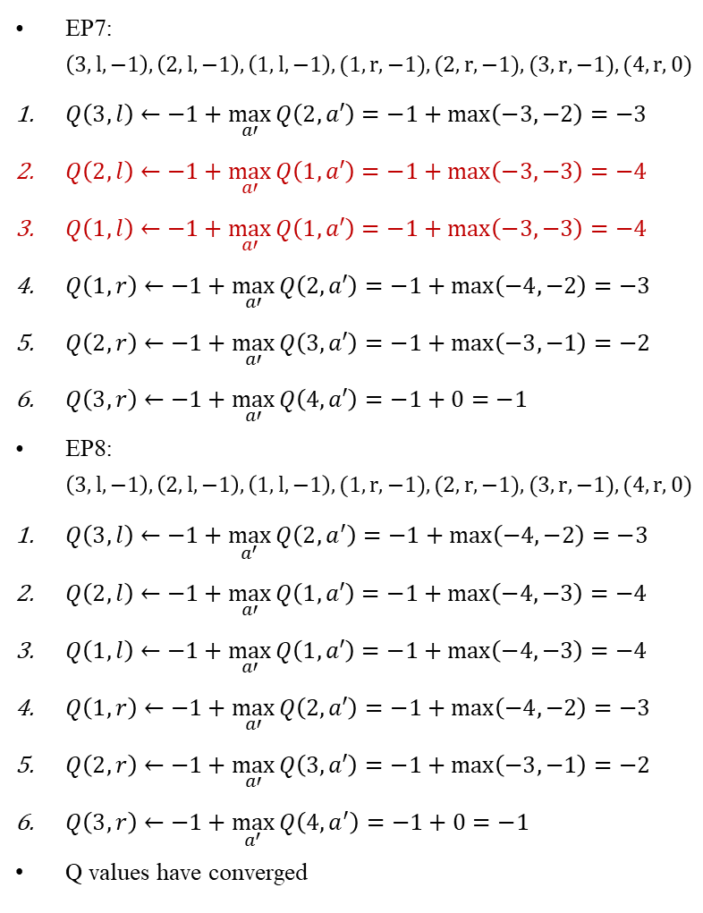
EP7-8
EP7: $\left(3, l, −1\right),\left(2, l, −1\right),\left(1,l, −1\right),(1, r, −1),(2, r, −1),(3, r, −1),(4, r, 0)$
$Q\left(3,l\right)←−1+\max_{a′}{Q\left(2,a′\right)}=−1+\max\left(−3,−2\right)=−3$
$Q\left(2,l\right)←−1+\max_{a′}{Q\left(1,a′\right)}=−1+\max\left(−3,−3\right)=−4$
$Q\left(1,l\right)←−1+\max_{a′}{Q\left(1,a′\right)}=−1+\max\left(−3,−3\right)=−4$
$Q\left(1,r\right)←−1+\max_{a′}{Q\left(2,a′\right)}=−1+\max\left(−4,−2\right)=−3$
$Q\left(2,r\right)←−1+\max_{a′}{Q\left(3,a′\right)}=−1+\max\left(−3,−1\right)=−2$
$Q\left(3,r\right)←−1+\max_{a′}{Q\left(4,a′\right)}=−1+0=−1$
EP8: $\left(3, l, −1\right),\left(2, l, −1\right),\left(1,l, −1\right),(1, r, −1),(2, r, −1),(3, r, −1),(4, r, 0)$
$Q\left(3,l\right)←−1+\max_{a^{′}}{Q\left(2,a^{′}\right)}=−1+\max\left(−4,−2\right)=−3$
$Q\left(2,l\right)←−1+\max_{a′}{Q\left(1,a′\right)}=−1+\max\left(−4,−3\right)=−4$
$Q\left(1,l\right)←−1+\max_{a′}{Q\left(1,a′\right)}=−1+\max\left(−4,−3\right)=−4$
$Q\left(1,r\right)←−1+\max_{a′}{Q\left(2,a′\right)}=−1+\max\left(−4,−2\right)=−3$
$Q\left(2,r\right)←−1+\max_{a′}{Q\left(3,a′\right)}=−1+\max\left(−3,−1\right)=−2$
$Q\left(3,r\right)←−1+\max_{a^{′}}{Q\left(4,a^{′}\right)}=−1+0=−1$
Q values have converged
QL | $$Q\left(1,l\right)$$ | $$Q\left(1,r\right)$$ | $$Q\left(2,l\right)$$ | $$Q\left(2,r\right)$$ | $$Q\left(3,l\right)$$ | $$Q\left(3,r\right)$$
Init | $$0$$ | $$0$$ | $$0$$ | $$0$$ | $$0$$ | $$0$$
After EP1 | $$0$$ | $$−1$$ | $$0$$ | $$−1$$ | $$0$$ | $$−1$$
After EP2 | $$0$$ | $$−1$$ | $$0$$ | $$−1$$ | $$0$$ | $$−1$$
After EP3 | $$0$$ | $$−1$$ | $$0$$ | $$−1$$ | $$0$$ | $$−1$$
After EP4 | $$−1$$ | $$−2$$ | $$−1$$ | $$−2$$ | $$−1$$ | $$−1$$
After EP5 | $$−2$$ | $$−3$$ | $$−2$$ | $$−2$$ | $$−2$$ | $$−1$$
After EP6 | $$−3$$ | $$−3$$ | $$−3$$ | $$−2$$ | $$−3$$ | $$−1$$
After EP7 | $$−4$$ | $$−3$$ | $$−4$$ | $$−2$$ | $$−3$$ | $$−1$$
After EP8 | $$−4$$ | $$−3$$ | $$−4$$ | $$−2$$ | $$−3$$ | $$−1$$
Notes:
EP6
$Q\left(3,l\right)←Q\left(3,l\right)+1\left(−1+\max_{a′}{Q\left(2,a′\right)}−Q\left(3,l\right)\right)=−2+1\left(−1+\max\left(−2,−2\right)+2\right)=−3$ (bootstraps off $Q\left(2,l\right)=−2$,$Q\left(2,r\right)=−2$.)
$Q\left(2,l\right)←Q\left(2,l\right)+1\left(−1+\max_{a′}{Q\left(1,a′\right)}−Q\left(2,l\right)\right)=−2+1\left(−1+\max\left(−2,−2\right)+2\right)=−3$(bootstraps off $Q\left(1,l\right)=−2$,$Q\left(1,r\right)=−2$.)
$Q\left(1,l\right)←Q\left(1,l\right)+1\left(−1+\max_{a′}{Q\left(1,a′\right)}−Q\left(1,l\right)\right)=−2+1\left(−1+\max\left(−2,−2\right)+2\right)=−3$ (bootstraps off $Q\left(1,l\right)=−2$,$Q\left(1,r\right)=−2$.)
$Q\left(1,r\right)←Q\left(1,r\right)+1\left(−1+\max_{a′}{Q\left(2,a′\right)}−Q\left(1,r\right)\right)=−2+1\left(−1+\max\left(−2,−2\right)+2\right)=−3$ (bootstraps off $Q\left(2,l\right)=−2$,$Q\left(2,r\right)=−2$)
EP5
$Q\left(3,l\right)←Q\left(3,l\right)+1\left(−1+\max_{a′}{Q\left(2,a′\right)}−Q\left(3,l\right)\right)=−1+1\left(−1+\max\left(−1,−2\right)+1\right)=−2$ (bootstraps off $Q\left(2,l\right)=−1$,$Q\left(2,r\right)=−2$.)
$Q\left(2,l\right)←Q\left(2,l\right)+1\left(−1+\max_{a′}{Q\left(1,a′\right)}−Q\left(2,l\right)\right)=−1+1\left(−1+\max\left(−1,−2\right)+1\right)=−2$ (bootstraps off $Q\left(1,l\right)=−1$,$Q\left(1,r\right)=−2$.)
$Q\left(1,l\right)←Q\left(1,l\right)+1\left(−1+\max_{a′}{Q\left(1,a′\right)}−Q\left(1,l\right)\right)=−1+1\left(−1+\max\left(−1,−2\right)+1\right)=−2$ (bootstraps off $Q\left(1,l\right)=−1$,$Q\left(1,r\right)=−2$.)
$Q\left(1,r\right)←Q\left(1,r\right)+1\left(−1+\max_{a′}{Q\left(2,a′\right)}−Q\left(1,r\right)\right)=−1+1\left(−1+\max\left(−2,−1\right)+1\right)=−2$
$Q\left(2,r\right)←Q\left(2,r\right)+1\left(−1+\max_{a′}{Q\left(3,a′\right)}−Q\left(2,r\right)\right)=−1+1\left(−1+\max\left(−2,−1\right)+1\right)=−2$
$Q\left(3,r\right)←Q\left(3,r\right)+1\left(−1+\max_{a′}{Q\left(4,a′\right)}−Q\left(3,r\right)\right)=−1+1\left(−1+0+1\right)=−1$

Slide 25
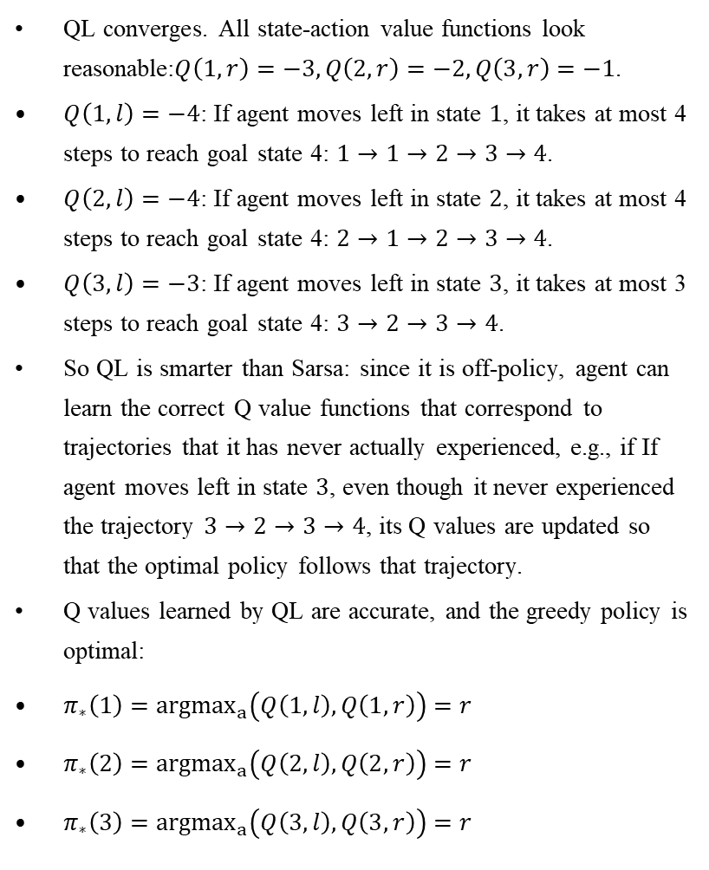
Comments on QL
QL converges. All state-action value functions look reasonable:$Q\left(1,r\right)=−3,Q\left(2,r\right)=−2,Q\left(3,r\right)=−1$.
$Q\left(1,l\right)=−4$: If agent moves left in state $1$, it takes at most 4 steps to reach goal state 4: $1→1→2→3→4$.
$Q\left(2,l\right)=−4$: If agent moves left in state $2$, it takes at most 4 steps to reach goal state 4: $2→1→2→3→4$.
$Q\left(3,l\right)=−3$: If agent moves left in state $3$, it takes at most 3 steps to reach goal state 4: $3→2→3→4$.
So QL is smarter than Sarsa: since it is off-policy, agent can learn the correct Q value functions that correspond to trajectories that it has never actually experienced, e.g., if If agent moves left in state $3$, even though it never experienced the trajectory $3→2→3→4$, its Q values are updated so that the optimal policy follows that trajectory.
Q values learned by QL are accurate, and the greedy policy is optimal:
$π_{∗}\left(1\right)={argmax}_{a}\left(Q\left(1,l\right),Q\left(1,r\right)\right)=r$
$π_{∗}\left(2\right)={argmax}_{a}\left(Q\left(2,l\right),Q\left(2,r\right)\right)=r$
$π_{∗}\left(3\right)={argmax}_{a}\left(Q\left(3,l\right),Q\left(3,r\right)\right)=r$
QL | $$Q\left(1,l\right)$$ | $$Q\left(1,r\right)$$ | $$Q\left(2,l\right)$$ | $$Q\left(2,r\right)$$ | $$Q\left(3,l\right)$$ | $$Q\left(3,r\right)$$
Init | $$0$$ | $$0$$ | $$0$$ | $$0$$ | $$0$$ | $$0$$
After EP1 | $$0$$ | $$−1$$ | $$0$$ | $$−1$$ | $$0$$ | $$−1$$
After EP2 | $$0$$ | $$−1$$ | $$0$$ | $$−1$$ | $$0$$ | $$−1$$
After EP3 | $$0$$ | $$−1$$ | $$0$$ | $$−1$$ | $$0$$ | $$−1$$
After EP4 | $$−1$$ | $$−2$$ | $$−1$$ | $$−2$$ | $$−1$$ | $$−1$$
After EP5 | $$−2$$ | $$−3$$ | $$−2$$ | $$−2$$ | $$−2$$ | $$−1$$
After EP6 | $$−3$$ | $$−3$$ | $$−3$$ | $$−2$$ | $$−3$$ | $$−1$$
After EP7 | $$−4$$ | $$−3$$ | $$−4$$ | $$−2$$ | $$−3$$ | $$−1$$
After EP8 | $$−4$$ | $$−3$$ | $$−4$$ | $$−2$$ | $$−3$$ | $$−1$$

